Slide 1
Classification of Poverty
Crystal Han

Slide 2
Introduction
HPSA (Health Professional Shortage Areas) Scores below 15 are considered in poverty (>10,000 datapoints)
Government can send Healthcare workers to impoverished areas to help
Target: Impoverished areas, places lacking healthcare workers
Agenda: Classify areas as in poverty or not in poverty and provide a direction on where to allocate healthcare workers

Slide 3



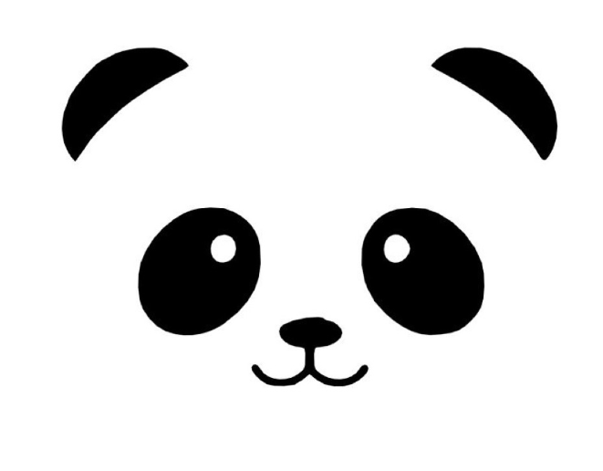


Methodology
Data
Health Professional Shortage Areas - Google Big Cloud Query
Supplementary Population County-state data - US Census Bureau
In poverty if HPSA < 15
Data filtered between 2010-2019

Slide 4
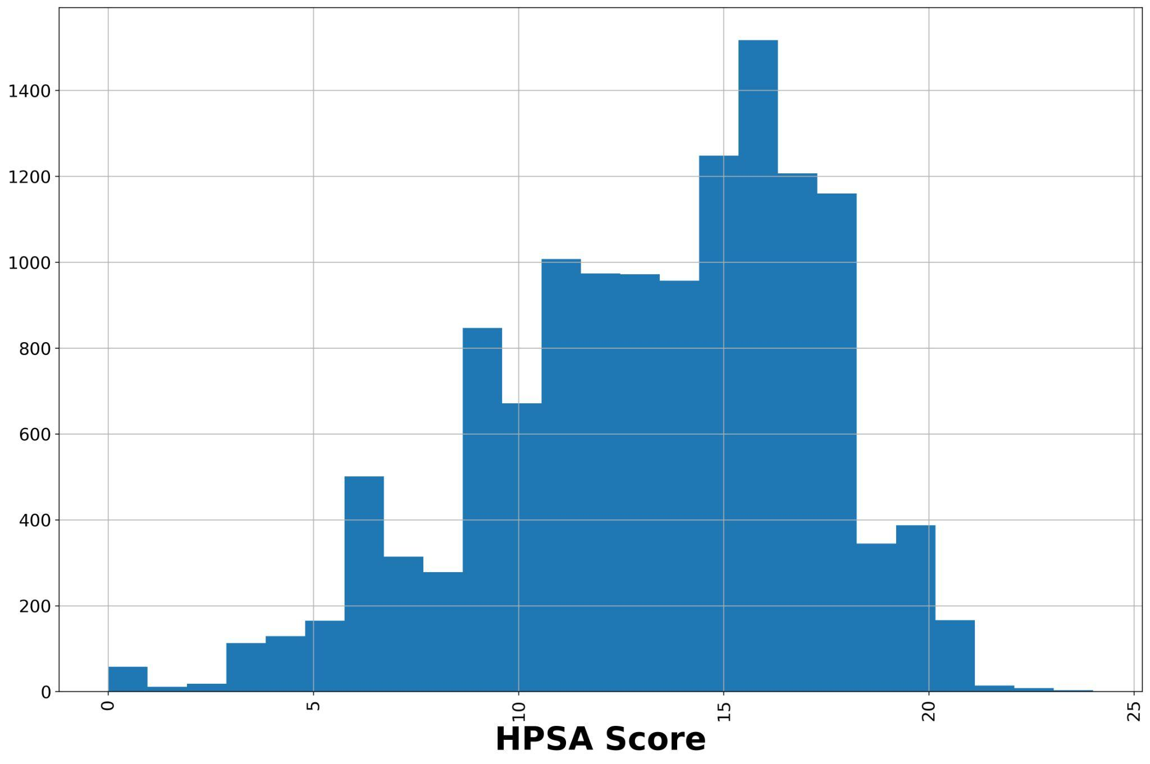
Histogram of HPSA Score

Slide 5
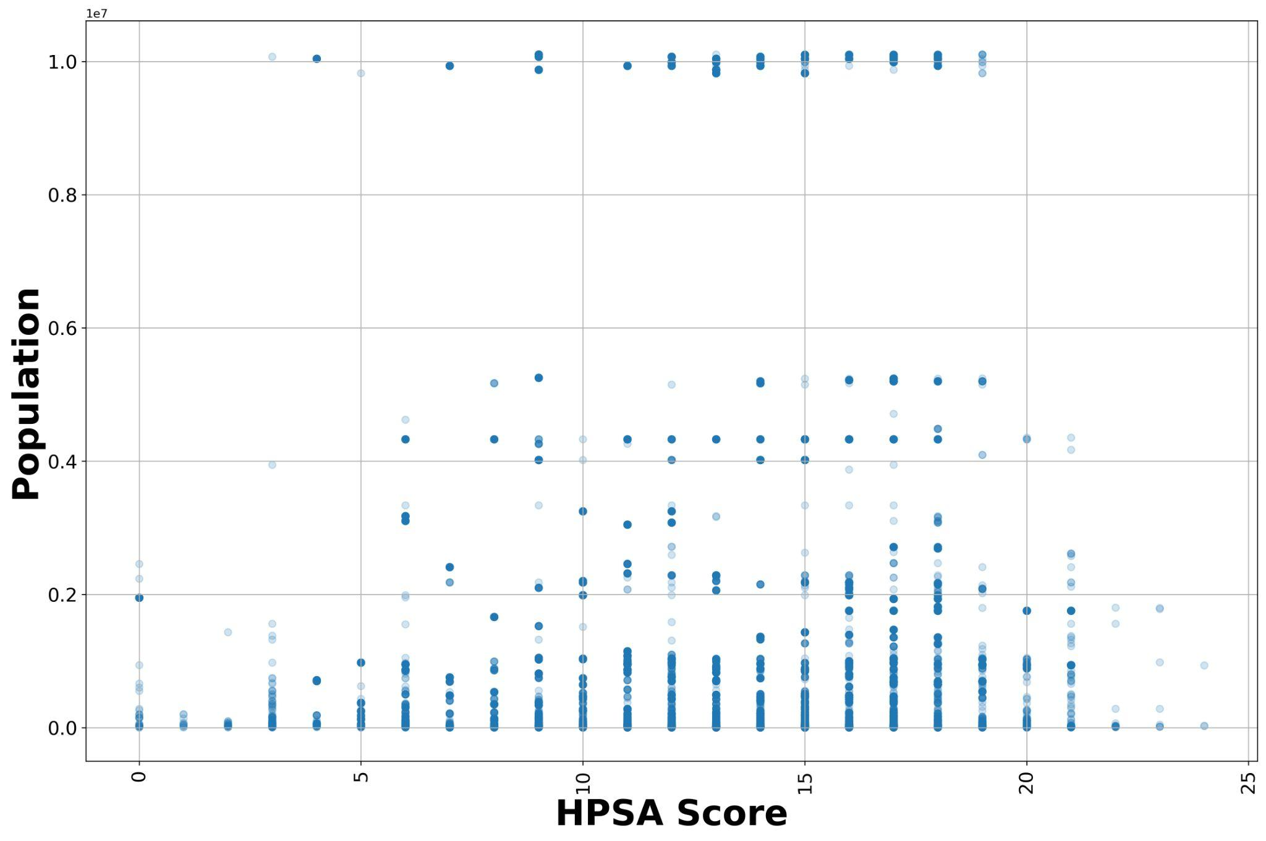
Population vs HPSA Score
Scatter Plot

Slide 6
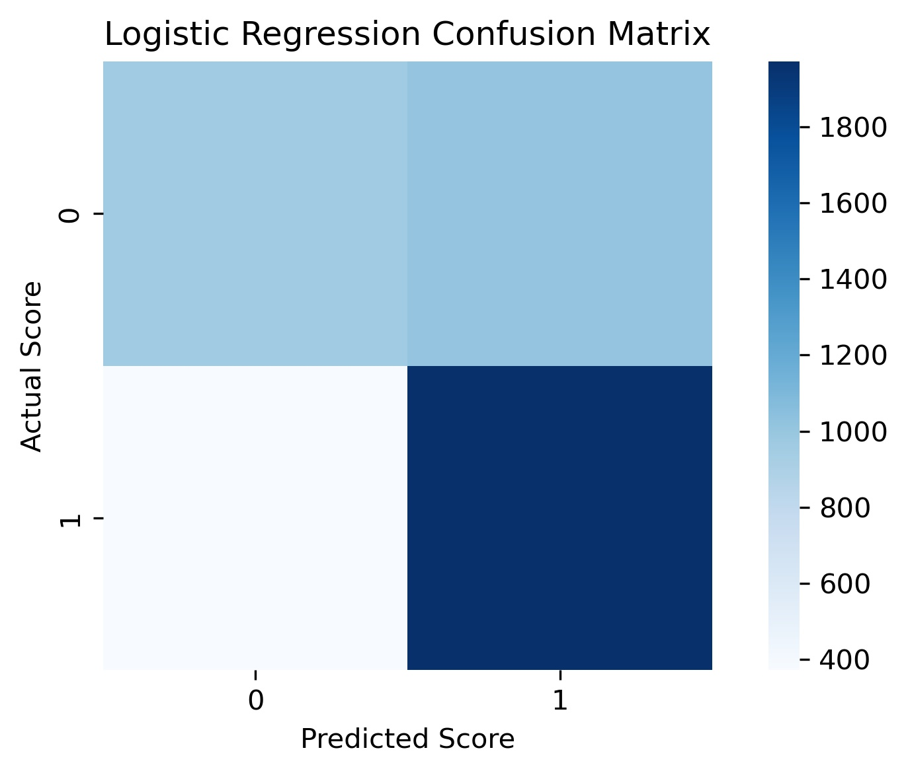
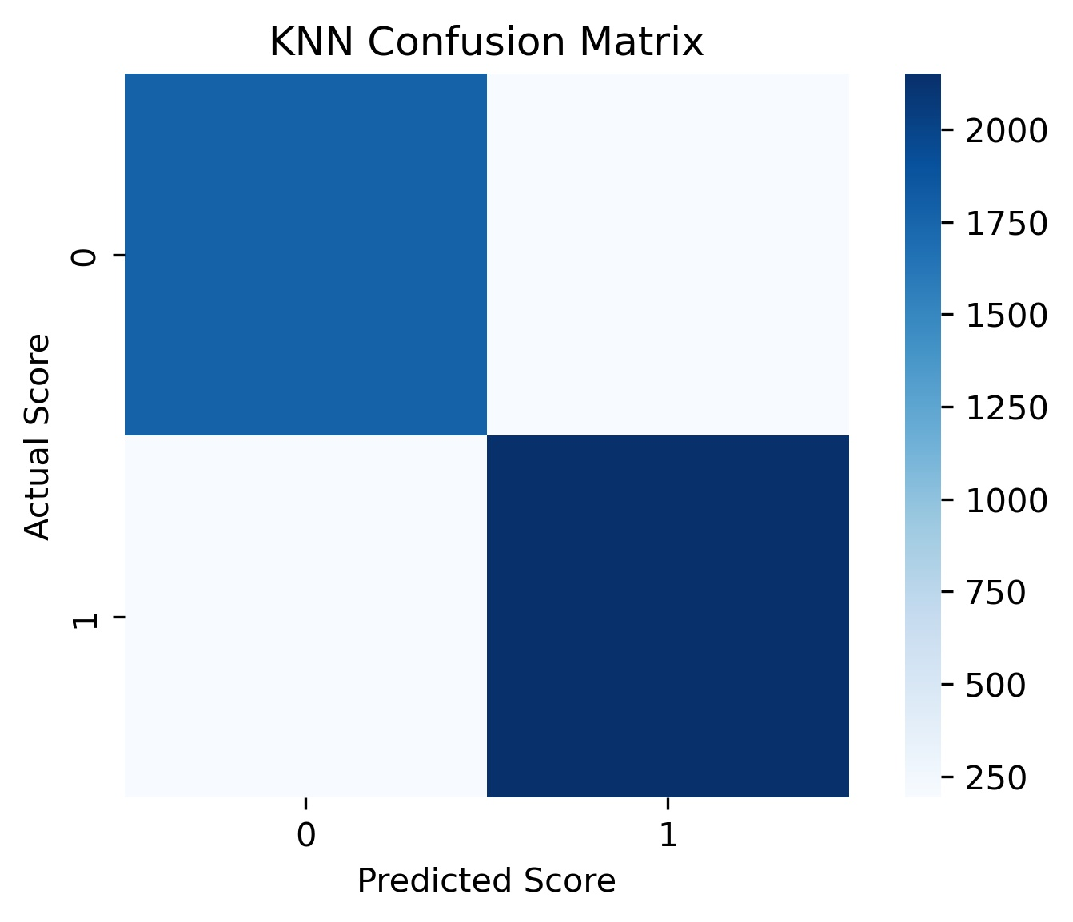
Confusion Matrix - Logistic vs KNN

Slide 7
Machine Learning Model Scoring
Model | Accuracy | Precision | Recall | F1 Score
Logistic Regression | 0.6785 | 0.6899 | 0.6630 | 0.6596
KNN | 0.9094 | 0.9087 | 0.9086 | 0.9086

Slide 8
Future Work
Using other machine learning models to predict and classify poverty
Compare levels and scores between previous decade with the current decade
Gather more supplementary and recent data to provide better classification and predictions

Slide 9
Conclusion
Poverty levels seen in populations less than 50 million
Other factors may cause poverty or shortage of healthcare workers
Model was able to predict and classify most of the data

Slide 10
Appendix
Time frame: 2010-2019
Data cleaning: Fixing some outliers that do not present normal behavior, dropped rows that had nan values as supplementary data was not found for it
Reason for selecting time frame:
More relatable with recent years as it workers can be allocated to those areas
Previous time frames had many more missing data and different templates of storing data that were difficult to handle or read

Slide 11
Thank you

